Slide 1
inQUIZit
……..
THE TECH QUIZ
Quiz By : AMAN PARAB
On the occasion of the IT department Council inauguration .

Slide 2
GEC QUIZ CLUB !!!!!!

Slide 3
ROUND 1

Slide 4
-10 questions!
- Infinite bounce!
- 4 pounces per team but 2 incorrect pounces and you cant pounce anymore!
+10 on direct!
+10/0 on pounce!

Slide 5
Q1) 15°25′23″N 73°58′48″E , Location of which place can be found out on Google maps represented by these geographical coordinates ?

Slide 6
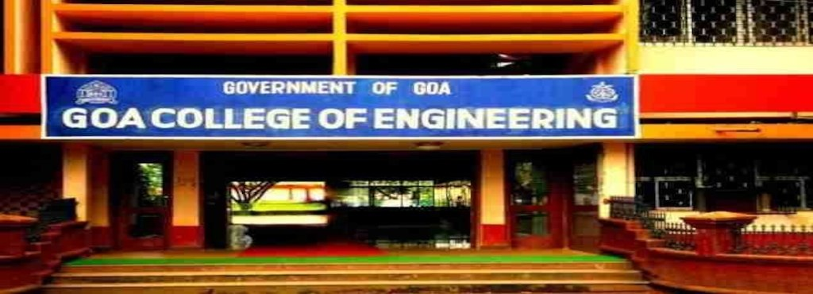
ANSWER
GEC/VELING

Slide 7
Q2) X was launched with a burning desire to create the World's largest collection of creative images with Indian faces.
Indians believe in sharing happiness and sorrow together as a community. While doing so, Indians share unique mannerisms and expressions which are captured in X's extensive library of creative imagery.
Founder of X is Y, who is a very famous Indian YouTube personality. ID X and Y

Slide 8
X:IMAGE BAZAAR
Y: SANDEEP MAHESHWARI

Slide 9
Q3) Three years later after Frederick Smith founded FedEx, rising fuel costs drove the company to the verge of bankruptcy -- it was losing over $1M per month.
When the company had just $5,000 left, Smith took the money and did something extra ordinary which made enough money to cover fuel costs and continue operations for a few days. It was enough time for Smith to then raise enough money to keep the company solvent.
What is this extraordinary thing that he did?

Slide 10
ANSWER :
Smith took all the money to Vegas and he played Blackjack there making a profit of
$32,000

Slide 11
Q4) "Be it a smartphone or feature phone of Rs 1,000-1,200, X can be used. There is no need to have Internet connectivity. One only needs a thumb. There was a time when an illiterate was called 'angutha chchap'. Now, time has changed. Your thumb is your bank now. It has become your identity now," said Narendra Modi .
What is the PM referring to ? (ID X)

Slide 12
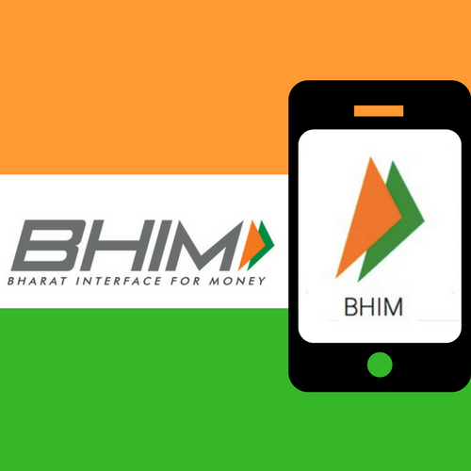
ANSWER

Slide 13
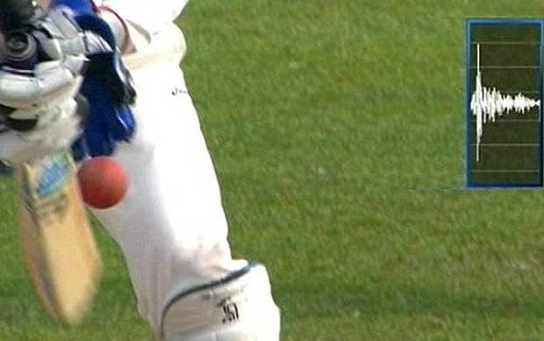
Q5) Over the years cricket has evolved a lot in terms of the technology used for decision making in the sport . One such technology named X has become an integral part of this game for decision making . X uses directional microphones to detect small sounds made as the ball hits the bat or pad . The use of X was suspended but was reintroduced in 2013 . ID X

Slide 14
X : SNICKOMETER/SNICKO

Slide 15
Q6) Android 8 or Oreo introduced a new format for app icons called X , which can display a variety of shapes for the icons across different device models . The look of X is defined by 2 layers , consisting of a background and a foreground image . ID X

Slide 16
X : ADAPTICONS/ADAPTIVE ICONS

Slide 17
Q7) X is a third-party logistics service provider, operating in over 1,200 cities in India . It was founded in 2011 by Sahil Barua, Mohit Tandon, Bhavesh Manglani, Suraj Saharan and Kapil Bharati . Delhi/NCR based X has so far raised $257 Mn in funding from a clutch of investors. The startup raised its last round in May 2017 at an estimated valuation of $650 Mn.
ID X

Slide 18
Here is a part of the startup’s logo.

Slide 20
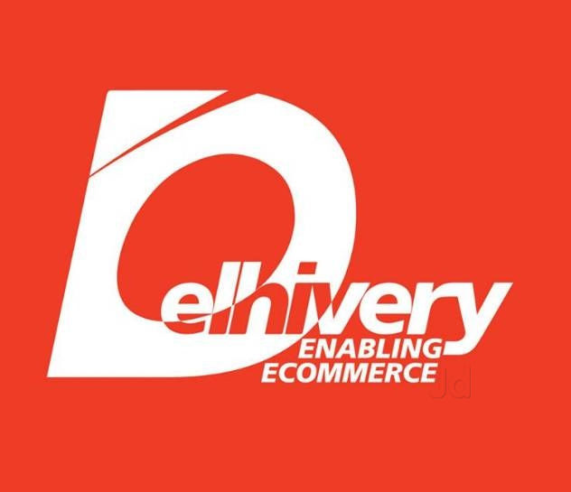
ANSWER

Slide 21
Q8) This is an inexhaustive list of what ?

Slide 22
MOST DOWNLOADED PAID APPS ON PLAYSTORE

Slide 23
Q9) Deplored by many for its removal of Windows’ iconic ____ ____ , Windows 8 in 2012 was the biggest rethink of Microsoft’s too-big-to-fail computing linchpin since Redmond first slapped a _____ _____in Windows 95’s lower left-hand corner. Consumers weren’t sure what to make of Microsoft’s colorful, tile-driven “Metro” interface, which worked fine on the company’s fledgling Surface tablets, but felt convoluted on laptops and desktops (which went on to account for virtually all of Windows 8’s market share). Fill in the blanks . (Blanks are indicative).

Slide 24
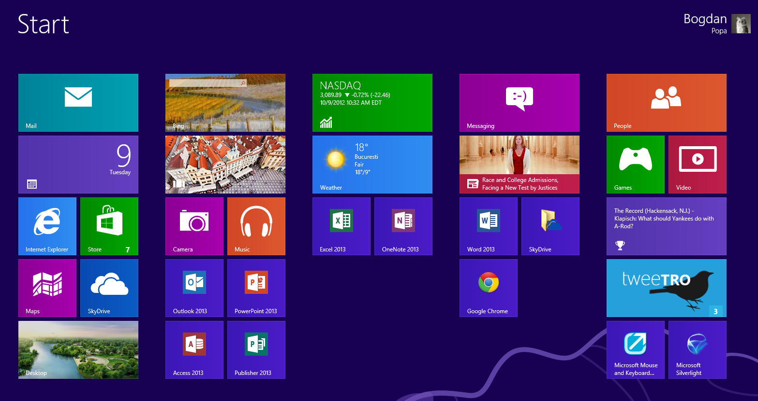
ANSWER: WINDOWS BUTTON/START BUTTON

Slide 25
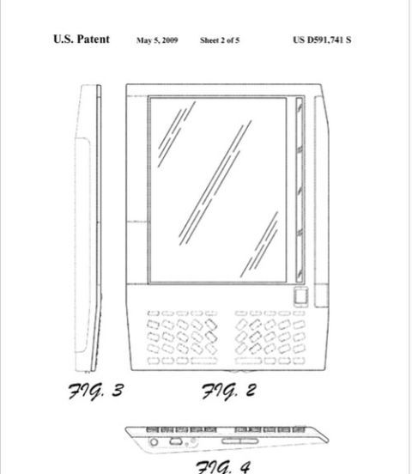
Q10) ID this patented product .
HINT : Amazon has the patent for this product

Slide 26
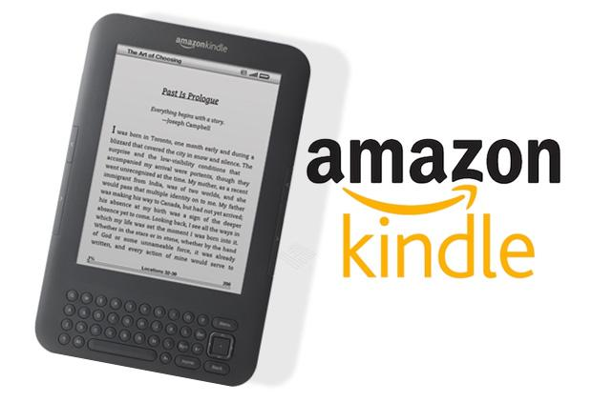
ANSWER

Slide 27
END OF ROUND 1!!!!!!!!!
SCORES PLZ!!!!!!

Slide 28
ROUND 2

Slide 29
Written Round
8 questions
+10 for each correct answer
If you get all 8 correct then additional +20
5 correct then additional +10

Slide 30
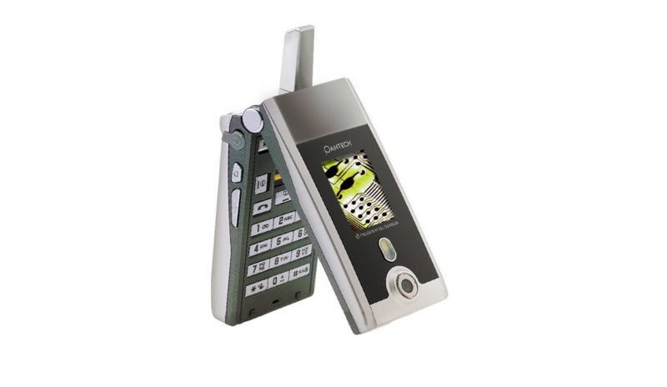
Q1) This is the PANTECH GL1100 . It was one of its kind cell phone when it was launched . This phone started something that all mid range to high end phones of today have . What was so special about this phone ?

Slide 31
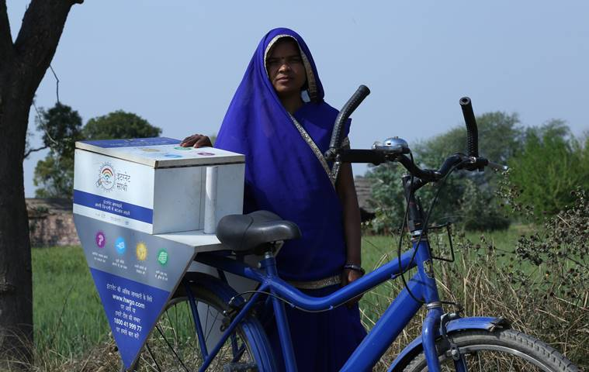
Q2) The Indian unit of search giant Google Inc and Tata Trusts have jointly launched X program (was launched in 2015) . It focuses on training women and larger communities to learn and explore various uses and benefits of the Internet . 15Milion women across 150000 villages of INIDA have benefited from this program . The program was recently started in Goa in the month of March . The above picture shows X . ID X

Slide 32

Q3) What did AMUL highlight through this very famous advertisement ?
Hint : It was one of the burning issues in INIDA a few years back .

Slide 33
Q4) After being acquired by the Chinese company ByteDance late last year, now the short-form video app and social media phenomenon X has been renamed Y .
Y , which is a similar service created and operated by ByteDance, was integrated with X .
According to reports, X accounts have been migrated to Y , which "incorporates the most popular elements of both apps.“
ID X and Y.

Slide 34
X
Q5) ID X

Slide 35
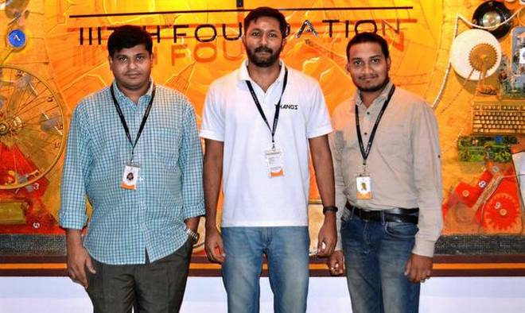
Q6) These 3 guys are the founders of a Hyderabad based startup named X . X uses drones as an effective pesticide – spraying technology in fields . Popular Indian news paper THE HINDU has termed X as a technological marvel . The name X is directly taken from a very popular character of the Marvel Comics and also the movies . The name X also translates into a never ending spirit . ID X

Slide 36
Q7) What is so special about this tweet by twitter CEO Jack Dorsey ?

Slide 37
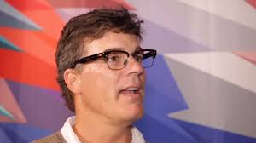
Q8) Andrew Anthony is a journalist who has written for The Guardian since 1990,and The Observer . Anthony is also the author of On Penalties (2000) and The Fall-Out (2007).
How is he related to EA sports?

Slide 38
END OF ROUND 2
EXCHANGE SHEETS PLZZ!!!!
……………………………
ANSWERS!

Slide 39
Q1) This is the PANTECH GL1100 . It was one of its kind cell phone when it was launched . This phone started something that all mid range to high end phones of today have . What was so special about this phone ?

Slide 40
FIRST PHONE EVER TO FEATURE A FINGER PRINT SCANNER

Slide 41
Q2) The Indian unit of search giant Google Inc and Tata Trusts have jointly launched X program (was launched in 2015) . It focuses on training women and larger communities to learn and explore various uses and benefits of the Internet . 15Milion women across 150000 villages of INIDA have benefited from this program . The program was recently started in Goa in the month of March . The above picture shows X . ID X

Slide 42
INTERNET SAATHI

Slide 43
Q3) What did AMUL highlight through this very famous advertisement ?
Hint : It was one of the burning issues in INIDA a few years back .

Slide 44
NET NEUTRALITY

Slide 45
Q4) After being acquired by the Chinese company ByteDance late last year, now the short-form video app and social media phenomenon X has been renamed Y .
Y , which is a similar service created and operated by ByteDance, was integrated with X .
According to reports, X accounts have been migrated to Y , which "incorporates the most popular elements of both apps.“
ID X and Y.

Slide 46
X : Musical.ly
Y : TIK TOK

Slide 47
X
Q5) ID X

Slide 48
FACEBOOK

Slide 49
Q6) These 3 guys are the founders of a Hyderabad based startup named X . X uses drones as an effective pesticide – spraying technology in fields . Popular Indian news paper THE HINDU has termed X as a technological marvel . The name X is directly taken from a very popular character of the Marvel Comics and also the movies . The name X also translates into a never ending spirit . ID X

Slide 50
THANOS

Slide 51
Q7) What is so special about this tweet by twitter CEO Jack Dorsey ?

Slide 52
FIRST TWEET EVER

Slide 53
Q8) Andrew Anthony is a journalist who has written for The Guardian since 1990,and The Observer . Anthony is also the author of On Penalties (2000) and The Fall-Out (2007).
How is he related to EA sports?

Slide 54
“EA SPORTS ITS IN THE GAME”………He gave his voice for this famous line

Slide 55
SCORES PLEASE

Slide 56
ROUND 3
ITS ALL ABOT THE LOGOS!!!!

Slide 57
+10/-10 on direct .
8 questions .
But there is a twist……..if you don’t know the answer you have to pass the question to any other team……if they get it correct then they get +10 and you get -10!
If they get it wrong 0 for both!
Order will be reversed after 4 questions .

Slide 58
Q1) The first logo featured a fish, which was a reference to a river located near the company’s offices.
Next, X chose a triangular logo, which was dropped in favor of a circular black and white logo in the 60’s. That was around the time when X was manufacturing electronic and cable products .
ID X
(old logos in the next slide)

Slide 59


1st logo of the company
Logo in 1960s

Slide 61
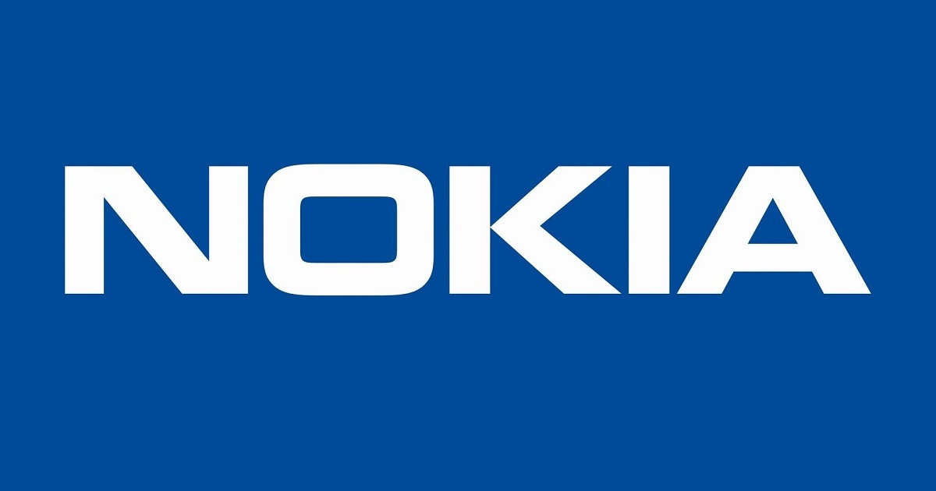
ANSWER

Slide 62
Q2) It is inspired by the bit and the atom , both building blocks of technology and the world , X explains about its new logo on its newly redesigned website .
Most of us don’t even think about or bits or atoms much if ever,” hinting at how deeply X thought about its new logo.
ID X

Slide 64



Slide 65
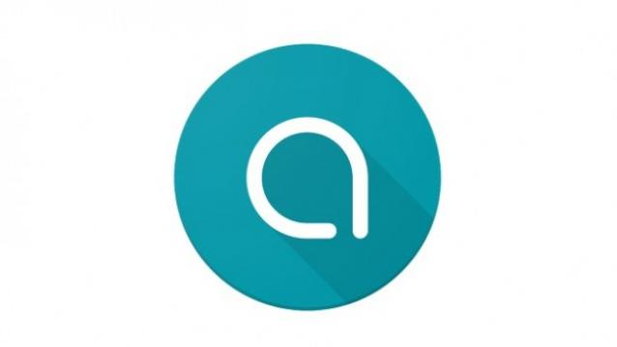
Q3) Name this app developed by Google

Slide 67
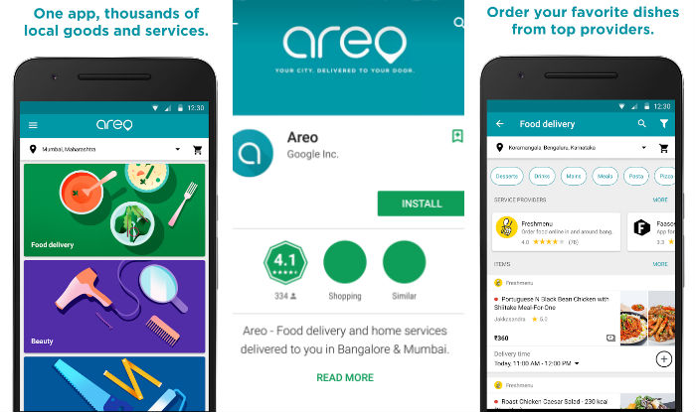
ANSWER

Slide 68
Q4) Which company’s logo is this ?

Slide 70
ANSWER

Slide 71
Q5) ID this company whose new and old logos are being compared

Slide 73
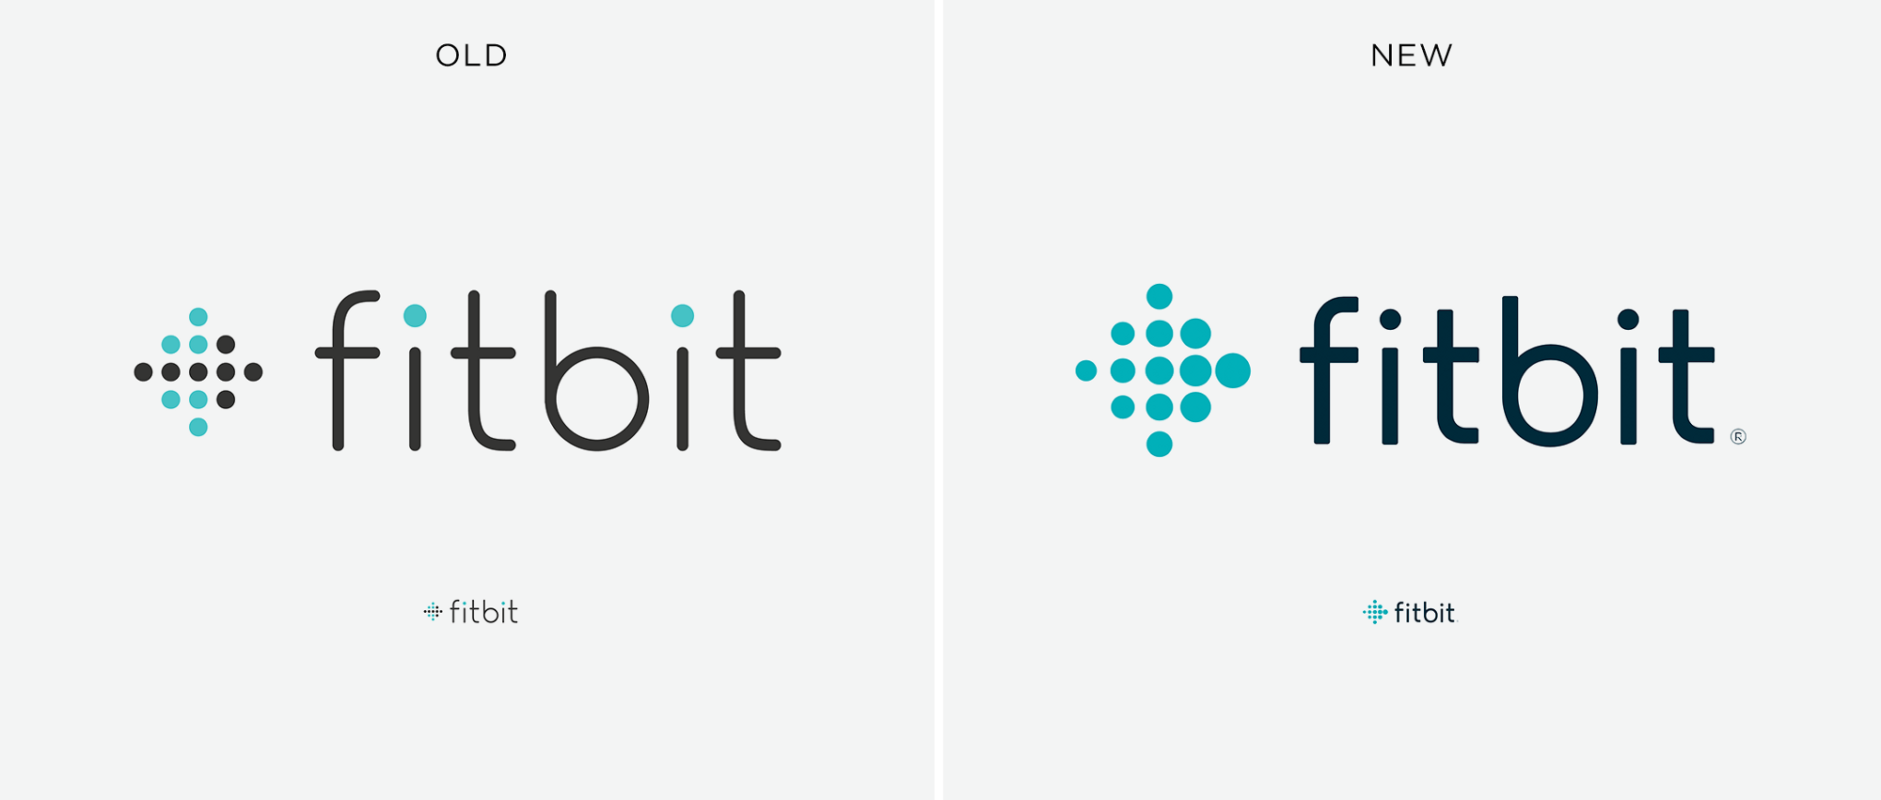

Slide 74

Q6) This is the first logo of something that I’m pretty sure almost all of you here have used atleast once . What is that something being talked about here ?

Slide 76

ANSWER

Slide 77
Q7) After the globe became unsuccessful over the years, X chose to create a more simplified logo in 1947, using just the initial letters in a bold, understated style. The current logo is very similar to the 1947 version, and was designed by Paul Rand. The capitalized lettering shows authority, the horizontal stripes represent the speed of the company’s products and the choice of blue reflects the professionalism of the brand. The current logo hasn’t changed since 1972 and is easily recognizable over the world because of its simplicity.

Slide 78

This was the company’s first logo!

Slide 80

ANSWER

Slide 81
Q8) Logo which famous laptop / top tier gaming gear manufacturing company ?

Slide 83

ANSWER

Slide 84
ROUND 4
The Final One!!!!

Slide 85
Theme round .
There are 6 questions in total which are connected to a particular theme .
+10 on direct .
Each team gets 3 pounces .
+10/-10 on pounce .

Slide 86

Q1) A software engineer who roamed the Cupertino corridors between 2003 and 2009, Evan Doll , co-founded the news and social network aggregation service X.
As the world of online news exploded Doll helped bring order to the chaos, with X allowing users to select what type of content they want to see, and from which publications.
ID X

Slide 88

ANSWER

Slide 89
Q2) _____ _____ is a technology company which manufactures wireless products with the aim of bringing affordable internet access to the emerging tech markets. The company is headquartered in San Jose, California. It was founded by Robert Pera in 2005 . He is also the owner of the Memphis Grizzlies, an American professional basketball team based in Memphis, Tennessee. In 2011, he became one of the youngest billionaires in the world. FITB

Slide 91
ANSWER

Slide 92
ANYONE GOING FOR THE THEME ???
+50/-40

Slide 93
Q3) Founded by Trip Hawkins , this world famous video game company has produced many famous games like Battlefield , Need For Speed , The Sims , Medal Of Honour , Crysis , NHL etc .
What company is being talked about here ?
This was the company’s first logo which has now been changed !

Slide 95

ANSWER

Slide 96
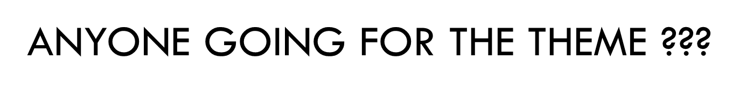
+40/-30

Slide 97
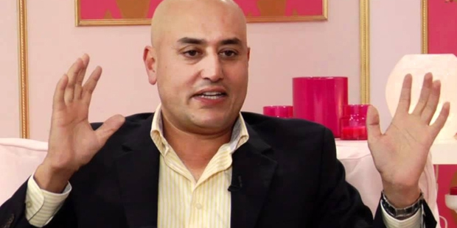

Q4) Connect

Slide 99
ANSWER

Slide 100
GOT IT ??? THEN GO FOR IT !!!
+30/-20

Slide 101
Q5) Founded on December 28, 2002,and launched on May 5, 2003,it is mainly used for professional networking, including employers posting jobs and job seekers posting their CVs. As of 2015, most of the company's revenue came from selling access to information about its members to recruiters and sales professionals. As of April 2017, X had 500 million members in 200 countries, out of which more than 106 million members are active.
One of it's subsidiaries is very famous among quizzers. ID X

Slide 103

ANSWER

Slide 104
COME ON NOW!!!!!!!!!!
+20/-10

Slide 105
-Andy Rubin co-founded this company in the year 2003.
-The early intentions of the company were to develop an advanced operating system for digital cameras.
-The company’s fortunes changed in the year 2005 when Google acquired it.
Which company am I talking about ?

Slide 107

ANSWER

Slide 108
NOW ATLEAST ?????
+10/0

Slide 110

ANSWER
ALL THESE FAMOUS COMPANIES WERE FOUNDED BY EX APPLE EMPLOYEES!!!!!!!

Slide 111
END OF THE FINAL ROUND!!!!!
SCORES PLZZZZ!!!

Slide 112
THAT’S ALL FOLKS !!!!!!! THANKS FOR COMING HERE !!!!! AND CONGRATS TO THE WINNERS !!!!! UNTIL NEXT TIME!!!!! SAYO NARA :p

